Slide 1





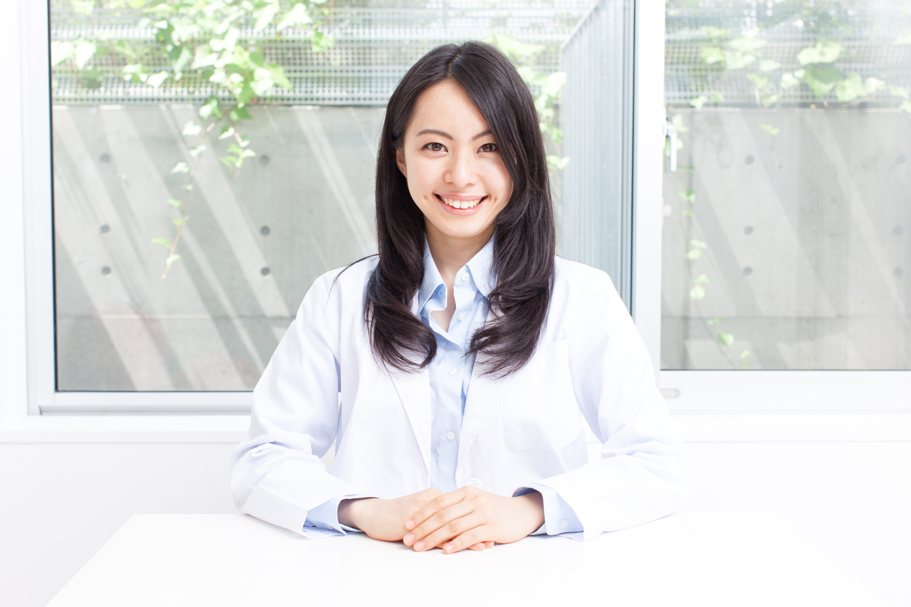



MEDICAL
HEALTH CARE
Development of a Skin
Disease Detection System
Using Neural Network

Slide 2
Team Members
MEDICAL
HEALTH CARE
Marina Emad Mored Habeb
Mera Refat Gaballah
Martina William Takawy
Sara Raafat Rasmy
Nardeen Maged Alfons
Mariam Sameh Fawzi
Marina Ashraf Farouk
2101013
2101090
2101031
2101569
2101354
2100979
2101014
Under the Supervision of
Dr. Amany Magdy Mohamed
lecturer in Computer and
Information Technology
Egyptian E-Learning University
T.A. Mohamed Mustafa
Teacher Assistant in Computer
and Information Technology
Egyptian E-Learning University

Slide 3
Agenda
2
Problem
Statement
3
Problem
Solution
4
Related Work
1
Introduction
5
Implementation
6
Result
7
Tools
8
Conclusion
9
Future Work
10
Time Plan
11
Referance

Slide 4

Introduction
1

Slide 5



Introduction
Skin diseases are common and can range from mild to severe conditions, requiring early detection and preventive measures.
Distinguishing between skin diseases can be challenging due to the overlap in symptoms.
This project proposes the development of a convolutional neural network-based system to automatically detect and classify skin diseases from images.
The aim is to give essential preventive advice until you visit the nearest doctor

Slide 6
Motivation
Dermatological diseases represent a significant global health challenge, affecting millions worldwide. Despite their common occurrence, diagnosing these conditions can often be complex and requires careful evaluation by specialists.
With the rising number of cases, the need for more accurate and efficient diagnostic methods has become crucial in improving healthcare delivery.
The application of artificial intelligence and Deep learning techniques has the potential to transform the diagnostic process, offering innovative solutions that can enhance speed and accuracy.

Slide 7
Motivation
The use of medical image analysis for dermatological diseases offers quicker, more precise diagnoses compared to traditional methods, which ultimately leads to better patient outcomes.
Due to all these motivations, we need a functional project that can accurately classify dermatological diseases while also providing preventive advice to help patients or their caregivers minimize potential complications until they can visitthe nearest doctor.

Slide 8
Problem Statement
2

Slide 9

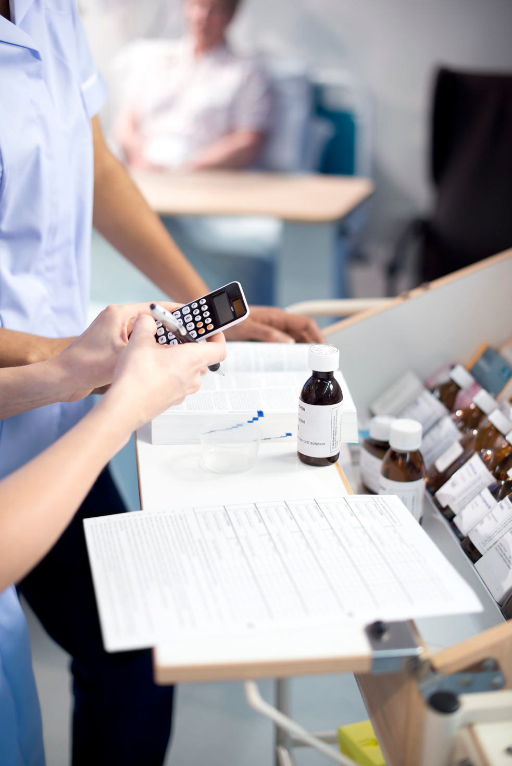
Problem Statement
Delay in diagnosis may lead to deterioration of the health condition, especially for skin diseases that can develop quickly if not treated on time.
Lack of awareness about skin diseases and preventive measures may cause anxiety and delay in taking appropriate actions.
Difficulty in distinguishing between skin diseases because of the similarity of images found on the internet.
Lack of awareness about nearby hospitals or specialized doctors for skin-related issues

Slide 10
Problem Solution
3

Slide 11

Problem Solution
The app provides instant diagnosis using artificial intelligence, helping to identify the condition quickly and prevent more complications.
The app offers reliable information about skin diseases and safety steps, with advice for care until seeing a doctor.
The app uses AI to analyze images accurately, helping to distinguish between different skin conditions and give accurate results.
The app allows users to find nearby hospitals or specialized clinics using an integrated map, making it easier to access treatment quickly.

Slide 12
Related Work
4

Slide 13
Related Work
paper | Published Date | Author | Algorithms
Skin Disease Detection using Image Processing and Machine Learning | May17,2023 | SamalJahnavi, Nallamilli Gayatri, Thota Sravani.Publication, ...elt. | Naive Bayes ( 97.5%) accuracy, SVM (90%) and KNN (93.75%)
Advance Sy Of Skin Diseases Detection Using Image Processing Methods | in 2022 | Dr.Sandra Paola , Dr. María A , Dr Jhony A, .....elt . | K-Nearest Neighbor (KNN) (91.2%) with Symlet Analysis, and (SVM) lower accuracy
A Method of Skin Disease Detection Using Image Processing and Machine Learning | in 2019 | Nawal Soliman ALKolifi ALEnezi . | Utilizes AlexNet (pretrained CNN) for feature extraction and Support Vector Machine (SVM) achieving (100%) accuracy
Table 1 : papers

Slide 14
Limitation
In previous studies related to dermatological disease classification, it was observed that the accuracy rates were not as high as they could have been.
Additionally, most of these studies focused on classifying only a limited number of diseases, which restricted the model's practical application. Expanding the scope to include a wider range of skin diseases would make the model more robust and versatile, addressing a critical gap in the existing research.

Slide 15
Implementation
5

Slide 16
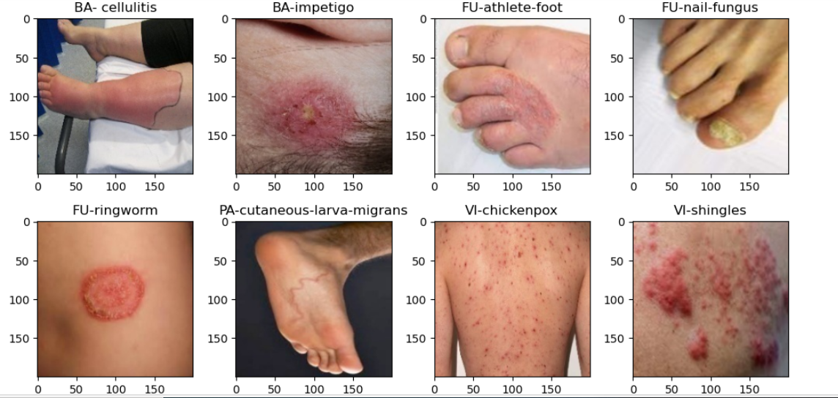
Dataset for Skin Diseases
In this dataset image collected .
The dataset consists of 1,159 images categorized into 8 skin diseases.
The data is divided into two subsets: 80% (924 images) for training and 20% (233 images) for testing.
Figuer 1 :Simple of datae

Slide 17
Dataset for Skin Diseases
Disease | Training Images | Testing Images | Total Images
Cellulitis | 135 | 33 | 168
Impetigo | 80 | 20 | 100
Athlete's Foot | 124 | 32 | 156
Nail Fungus | 129 | 33 | 162
Ringworm | 90 | 23 | 113
Cutaneous Larva Migrans | 100 | 30 | 125
Chickenpox | 136 | 34 | 170
Shingles | 130 | 33 | 163
Total | 924 | 233 | 1157
Table2 :Dataset

Slide 18
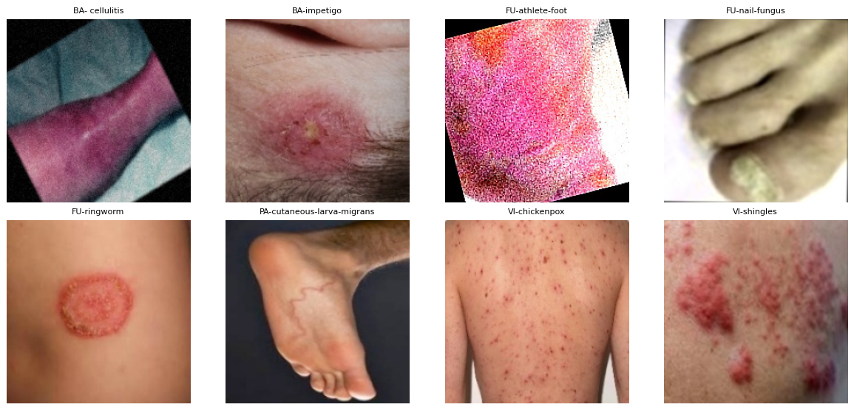
Dataset for Skin Diseases
Because the limited number of images in the original training dataset, data augmentation techniques were applied to increase the dataset size and enhance its diversity. This process contributed to improving the model's performance and generalization. After augmentation, the dataset was expanded to include 4052 images for training and 233 images for testing, all categorized into 8 distinct skin diseases.
Figuer 2 :Simple of datae

Slide 19
Dataset for Skin Diseases
Disease | Training Images | Testing Images | Total Images
Cellulitis | 879 | 33 | 912
Impetigo | 440 | 20 | 460
Athlete's Foot | 418 | 32 | 450
Nail Fungus | 516 | 33 | 549
Ringworm | 450 | 23 | 473
Cutaneous Larva Migrans | 378 | 30 | 408
Chickenpox | 493 | 34 | 527
Shingles | 478 | 33 | 511
Total | 4052 | 233 | 4285
Table 3 :Dataset

Slide 20
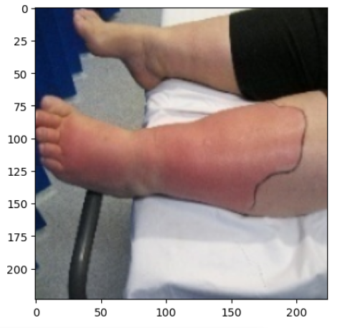
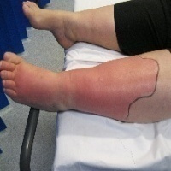
Image Preprocessing
1-Images resized to 224×224.
Before
After
Figuer 3 :Resize Image

Slide 21

Image Preprocessing
2-Encoded the categories using One-Hot Encoding so that the model can handle the categories correctly during training, which helps it produce accurate outputs in the end. This includes ensuring the data is intact during the training and prediction process .

Slide 22
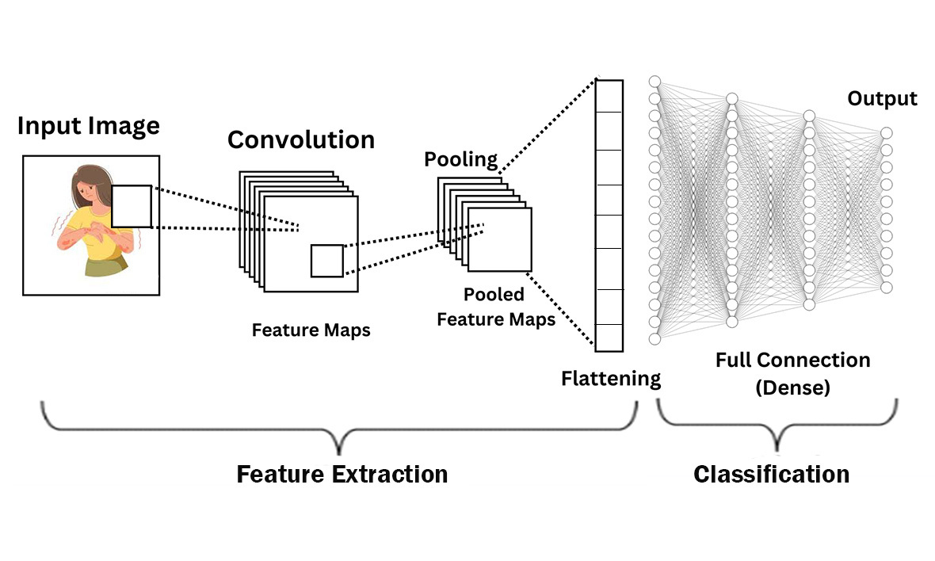
CNN
Using this images, we apply a Deap learning models to predict skin disease.
Figuer 4 : CNN architecture

Slide 23
Models of CNN
Models | EfficientNetB0 | ResNet50 | VGG16 | InceptionV3 | MobileNet
Pooling Layer | GlobalMax Pooling2D | GlobalAverage Pooling2D | GlobalMax Pooling2D | GlobalAverage Pooling2D | GlobalAverage Pooling2D
Hidden Layer | Fully connected layer with 512 neurons, ReLU | Fully connected layer with 512 neurons, ReLU | Fully connected layer with 256 neurons, ReLU | Fully connected layer with 512 neurons, ReLU | Fully connected layer with 1024 neurons , Relu
Dropout | 50% | N/A | 50% | 50% | N/A
Notes | Pre-trained on ImageNet; base layers frozen; output Softmax for 8 classes | Pre-trained on ImageNet; 50 layers; base layers frozen; output Softmax for 8 classes | Pre-trained on ImageNet; 16 layers; base layers frozen; output Softmax for 8 classification | Pre-trained on ImageNet; uses Inception modules for multi-scale feature extraction; base layers frozen; output Softmax for 8 classes | Pre-trained on ImageNet; lightweight and optimized for mobile/embedded systems; base layers frozen; output Softmax for 8 classes
Table 4 : Models of CNN

Slide 24
Parameter of models with grid search
Models | EfficientNetB0 | ResNet50 | VGG16 | InceptionV3 | MobileNet
Optimizer | Adam with a learning rate of 0.001 | Adam with a learning rate of 0.001 | Adam with a learning rate of 0.0002 | Adam with a learning rate of 0.0002 | Adam with a learning rate of 0.001
Loss Function | Categorical Crossentropy | Categorical Crossentropy | Categorical Crossentropy | Categorical Crossentropy | Categorical Crossentropy
Epochs | 20 | 20 | 20 | 20 | 10
Batch Size | 128 | 32 | 32 | 32 | 32
Accurecy | 96.9% | 94.5% | 93.0% | 94.4% | 94.0%
Table 5: Parameter of models

Slide 25
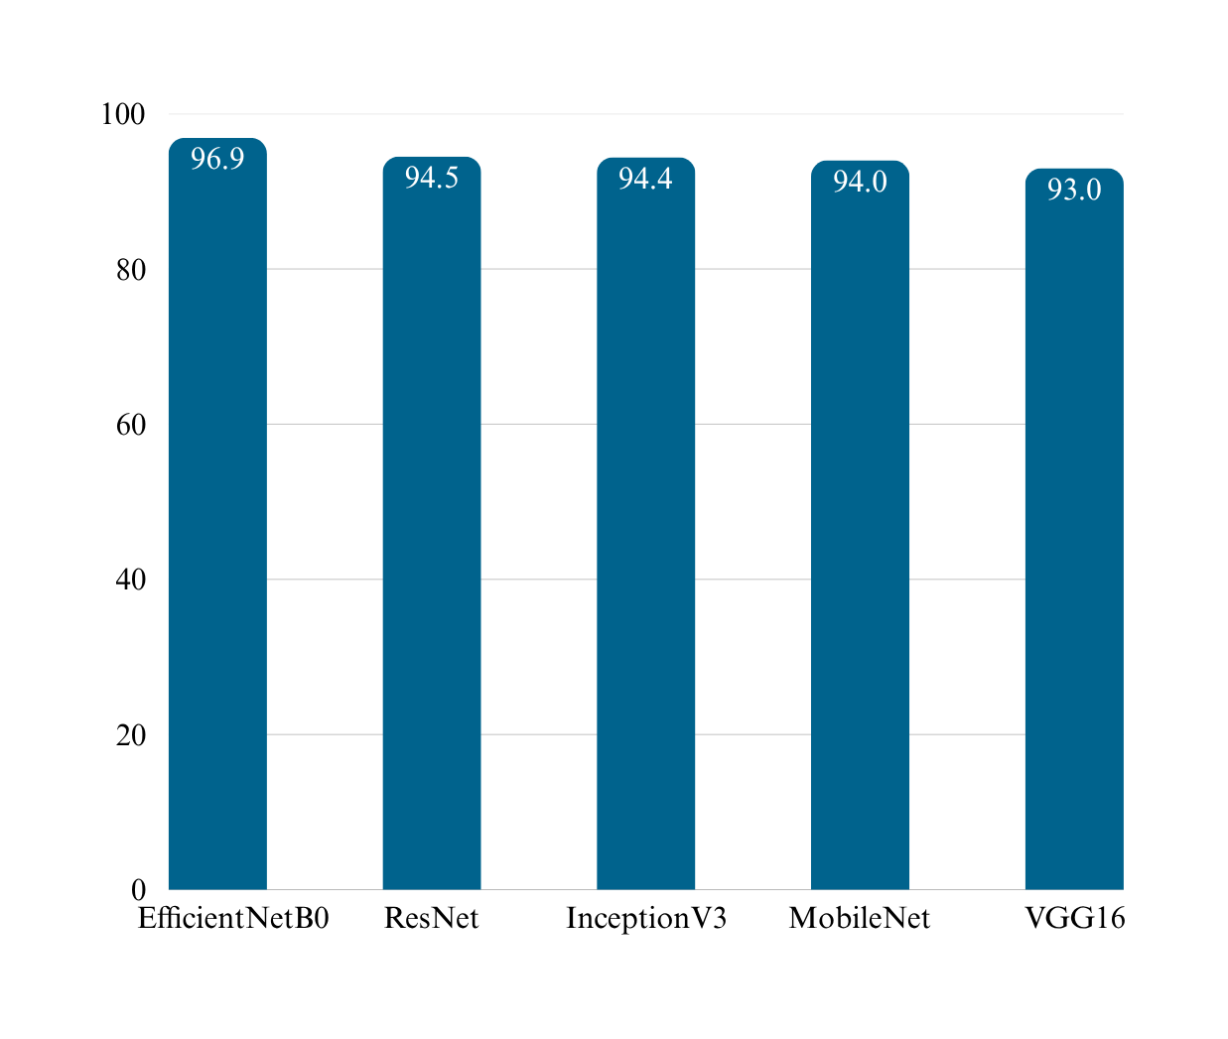

CNN Models
Figuer 5 : Best Accurecy

Slide 26
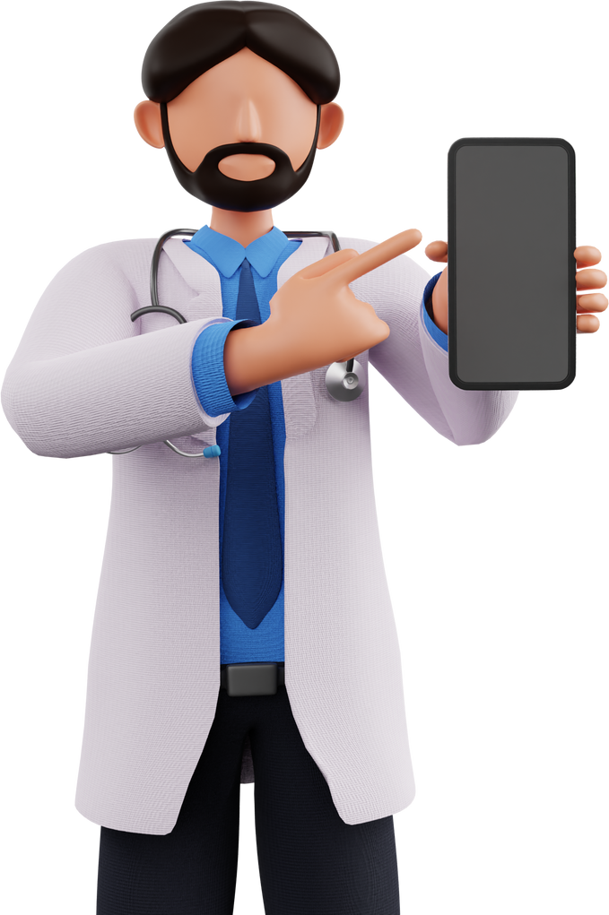

Flutter Application
The project was implemented using Flutter, providing a smooth and highly responsive user experience.
The core functionality is powered by a CNN model(EfficientNetB0), which was trained to enable accurate diagnosis of skin conditions.

Slide 27
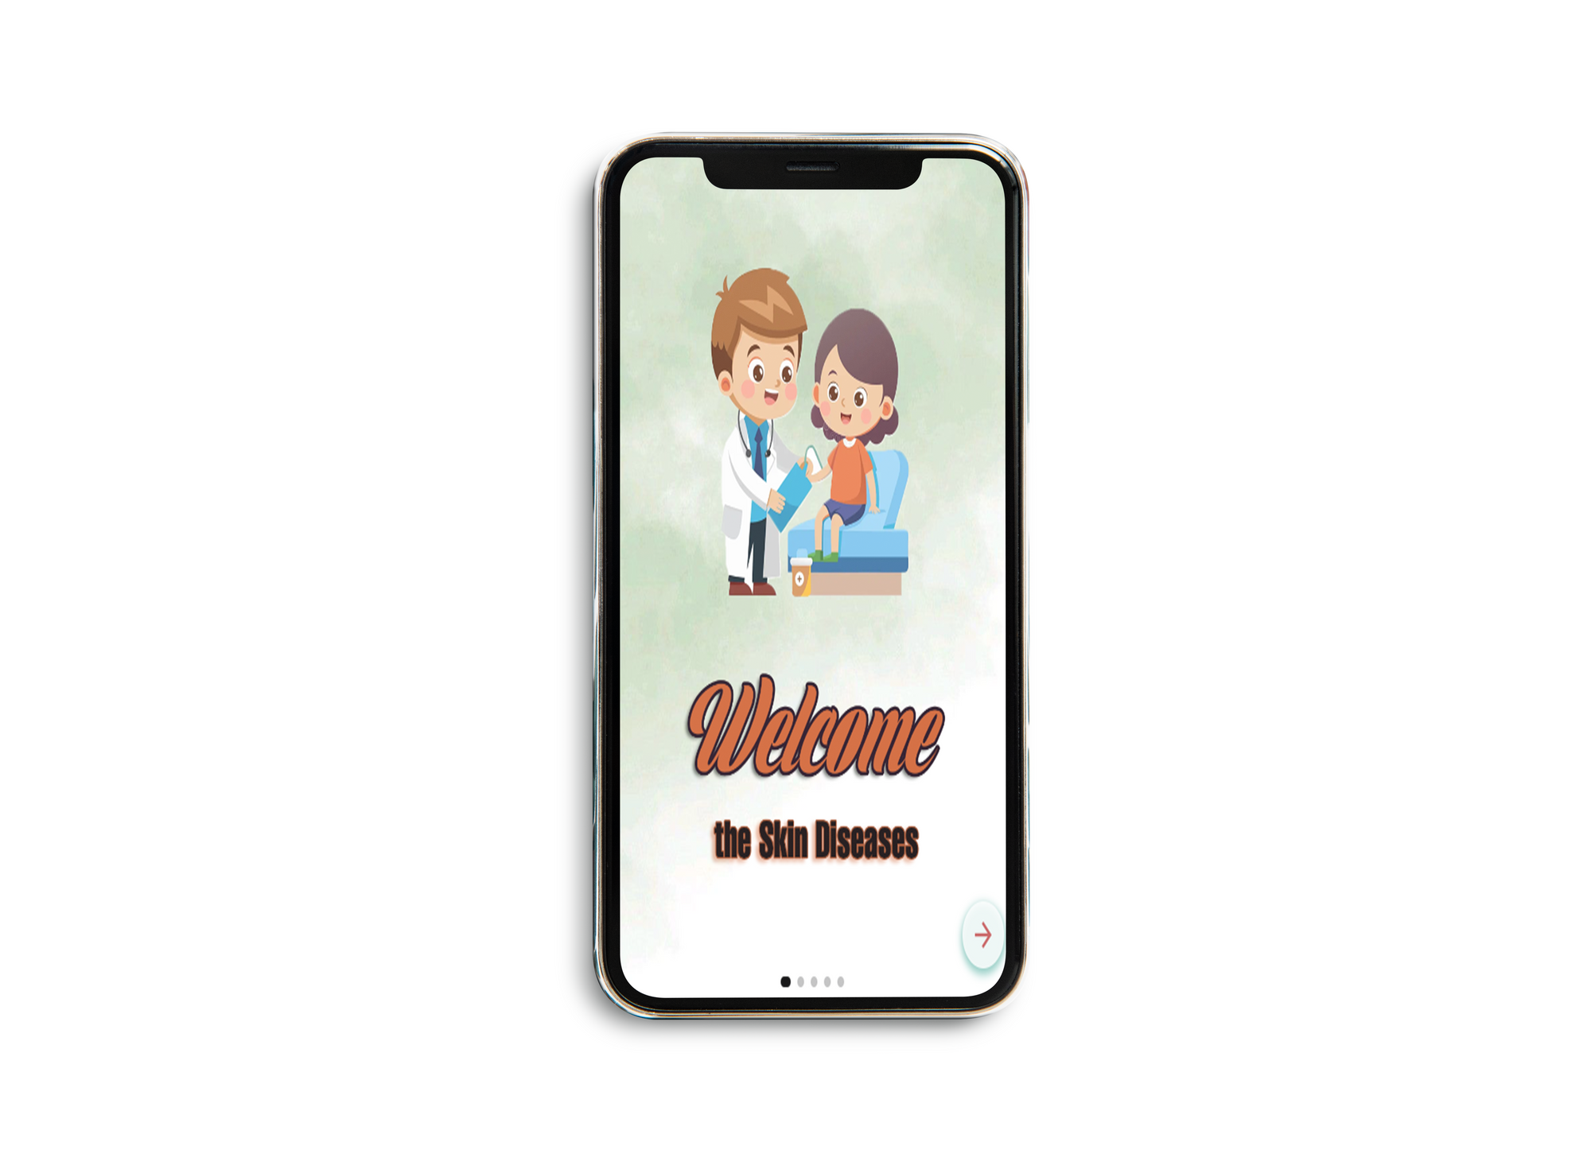
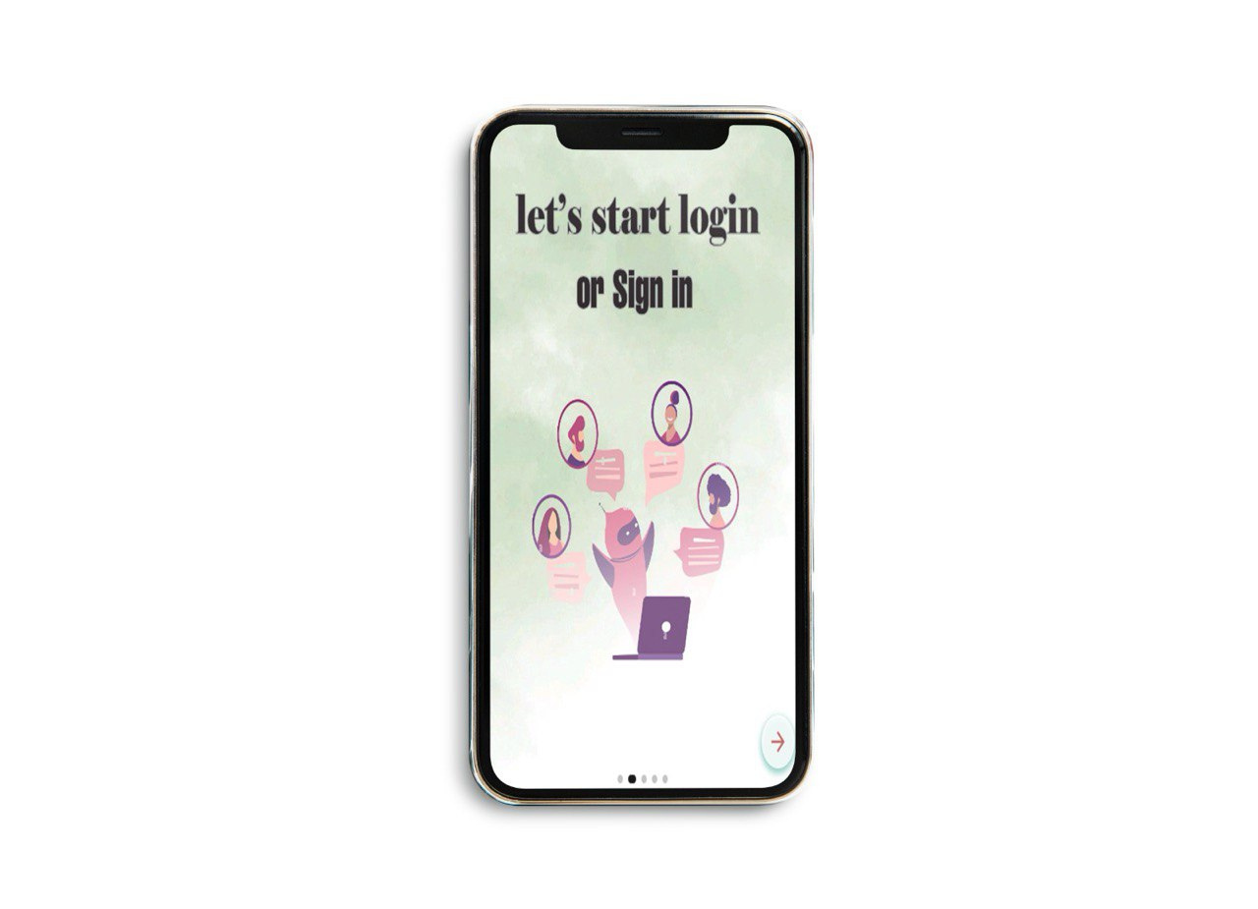
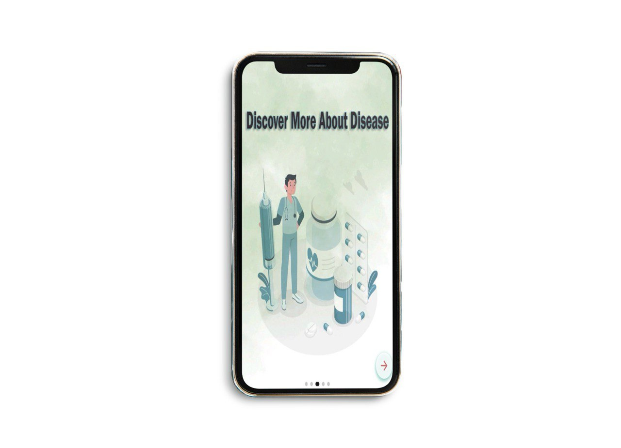
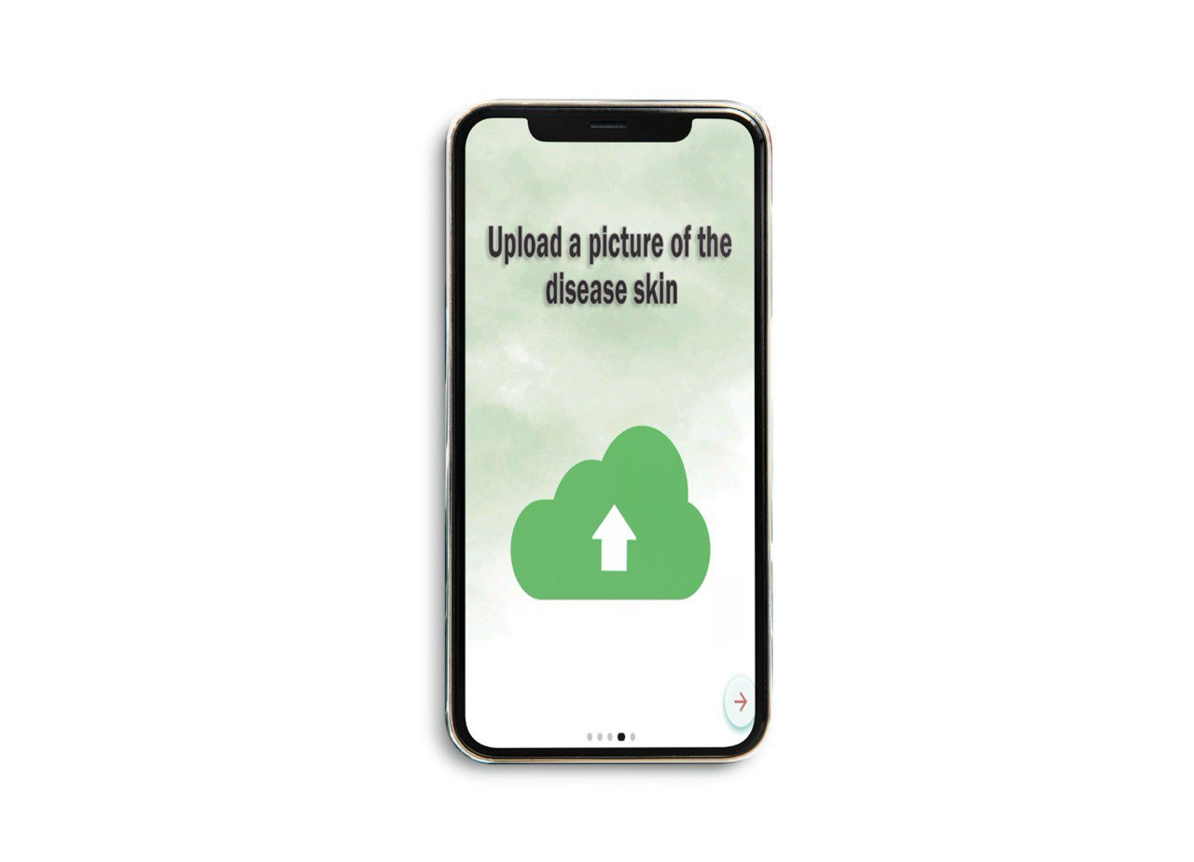
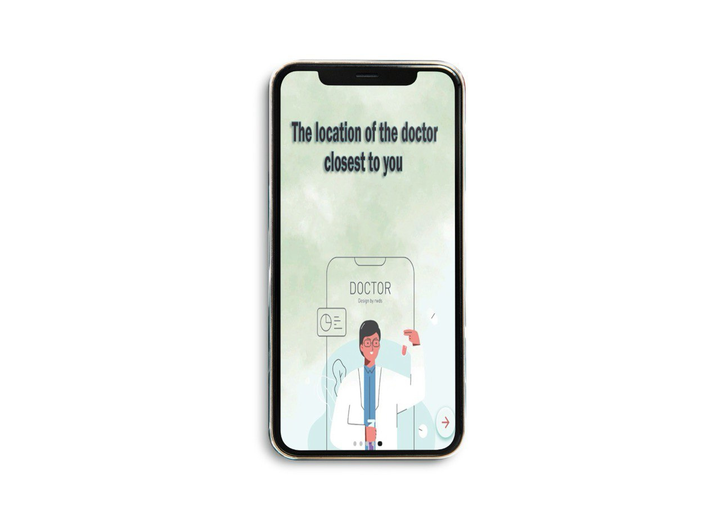
Skin Disease Diagnosis App
Figuer 6 : Splash screen
The app begins with a splash screen that highlights its key features.

Slide 28
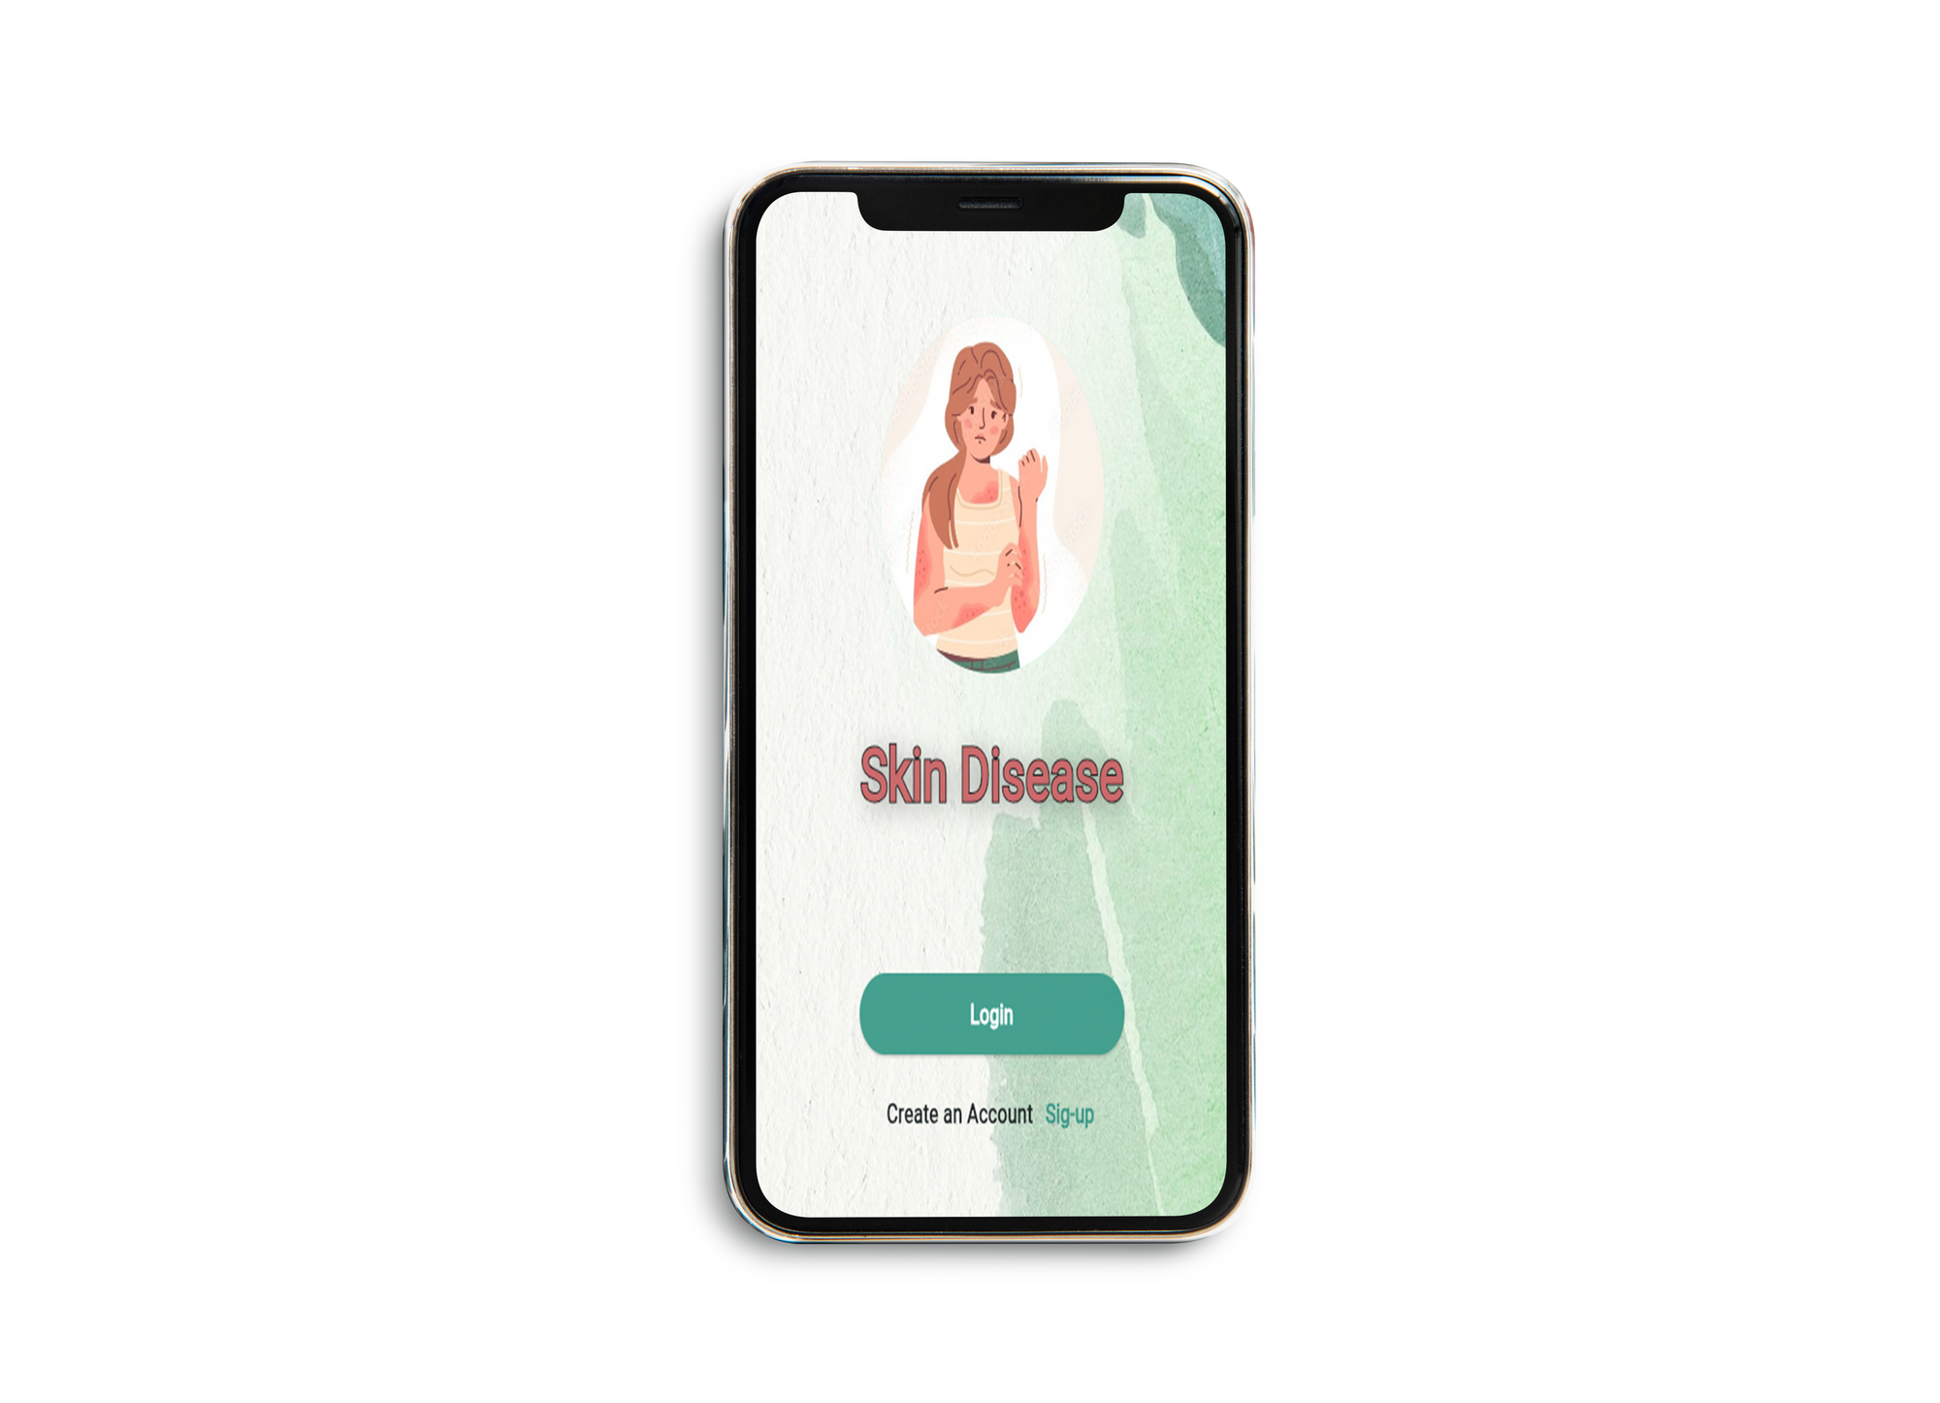
Join App view
In the first phase, the application focused on facilitating easy access to diagnosis and finding the nearest doctor through a program interface that allows users to:
Log in if they already have an account.
Sign up to create a new account and join the app.
Figuer 7 :Home page

Slide 29
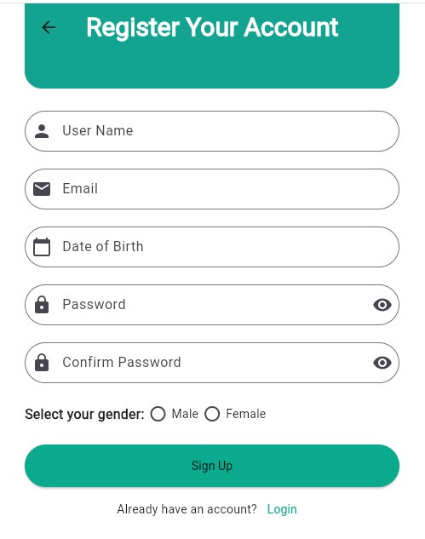
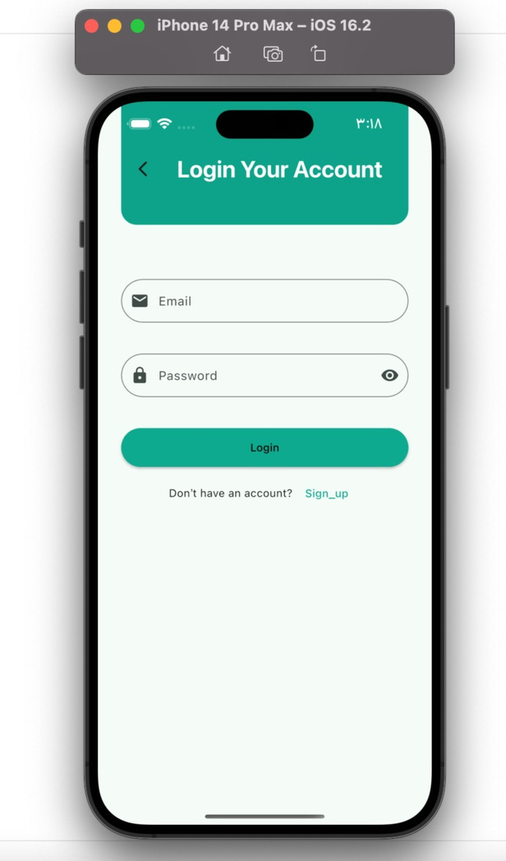
The app interface provides a simple and seamless experience for logging in or signing up
Figuer 8 : Login & Sign-Up Page

Slide 30
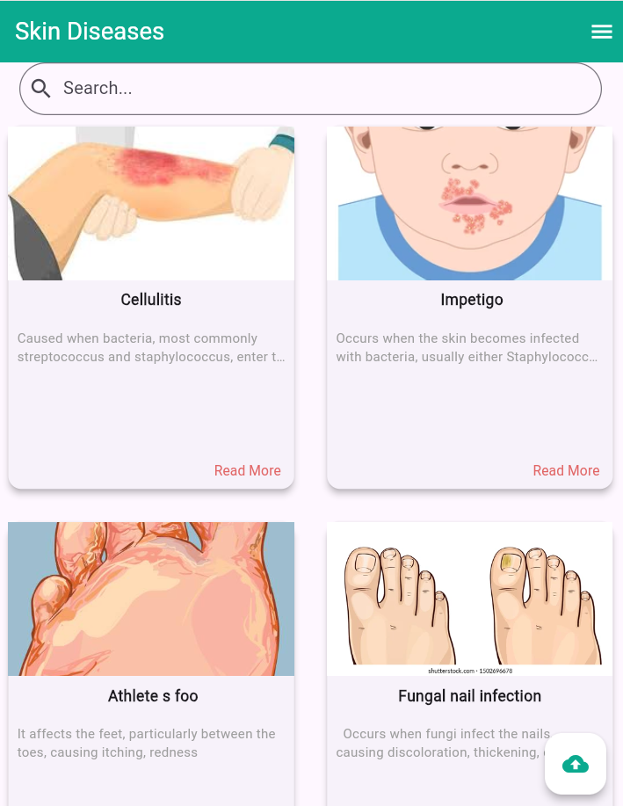
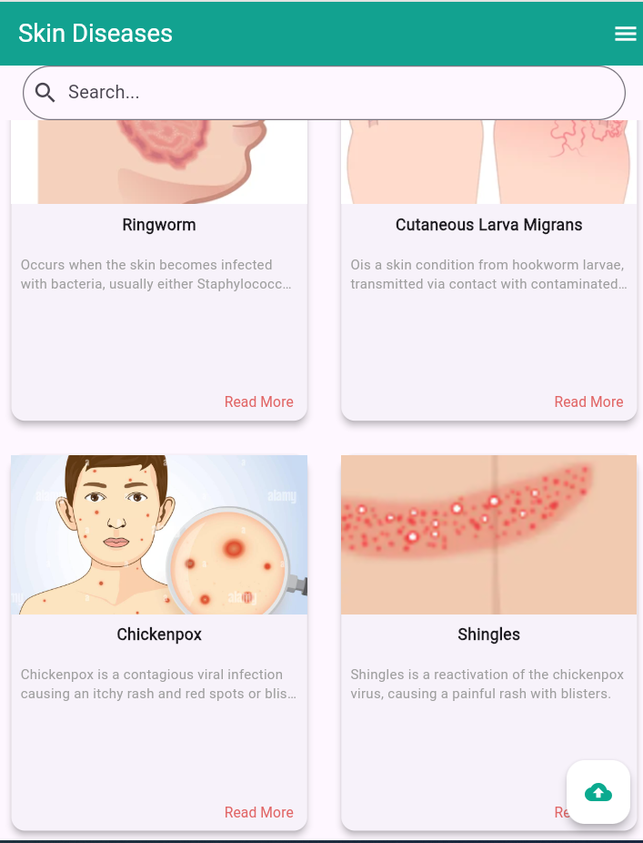
The Diseases Page
The app displays a list of 8 skin conditions, each represented with an image, name, and a brief description. Users can click 'Read More' for detailed information about any disease.
It also features a search bar to help users easily find diseases by name.
Figuer 9 : Skin Conditions Overview

Slide 31
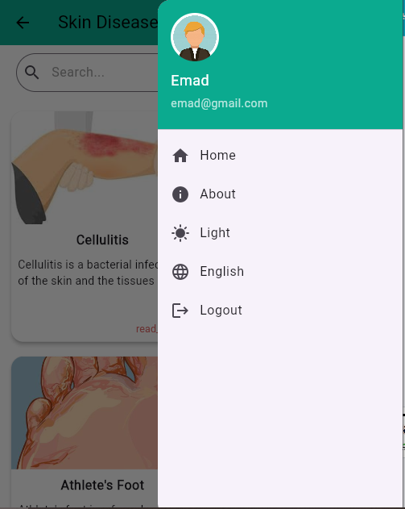
List
User Info:
Displays avatar (gender-based), username & email pulled live from Firestore
Quick List:
- Home
- About
- Light / Dark mode
- English / Arabic
- Logout
Tap any option to go there instantly
Figuer 10 : List

Slide 32
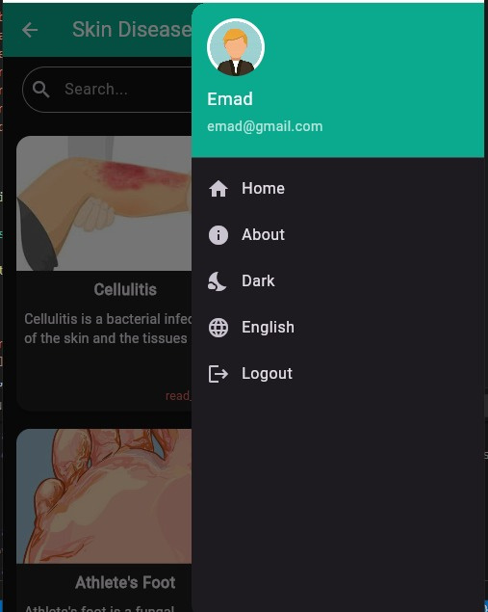
Dark Mode
Figuer 11 : Dark Mode
With one click, users can switch between Light and Dark themes,
making the app more comfortable to use in different lighting conditions

Slide 33
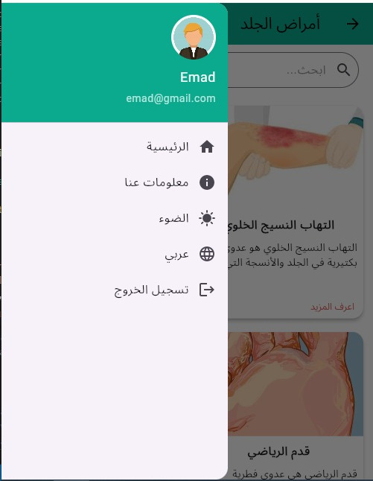
Translate
Figuer 12 :Translate
The app supports Arabic and English, so it's easy for anyone to use.

Slide 34
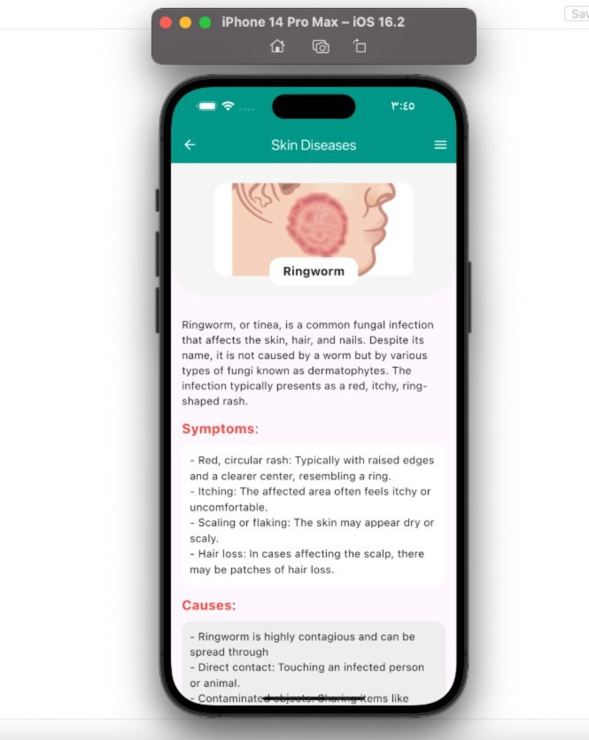
The Diseases Page
The app allows users to explore detailed information about each skin condition, including:
Symptoms.
Causes.
Prevention.
This feature ensures users have access to in-depth knowledge to better understand their condition
Figuer 13 : Disease Details

Slide 35
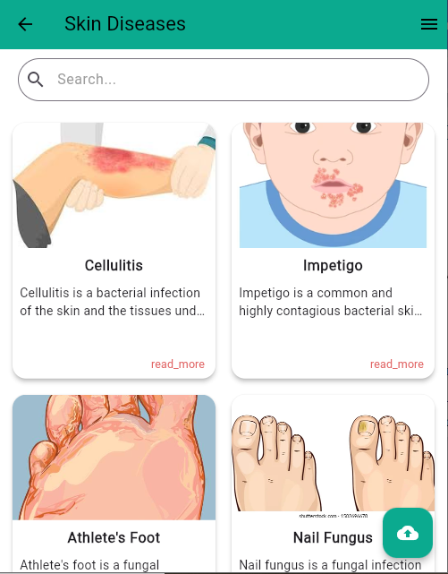
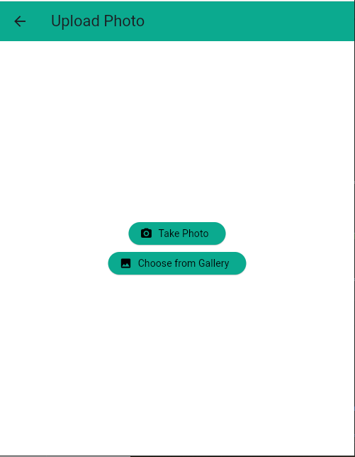

Upload Your Photo for Diagnosis
Figuer 14: Image Upload
Users can upload an image for analysis by either:
Capturing via camera or selecting from the gallery

Slide 36
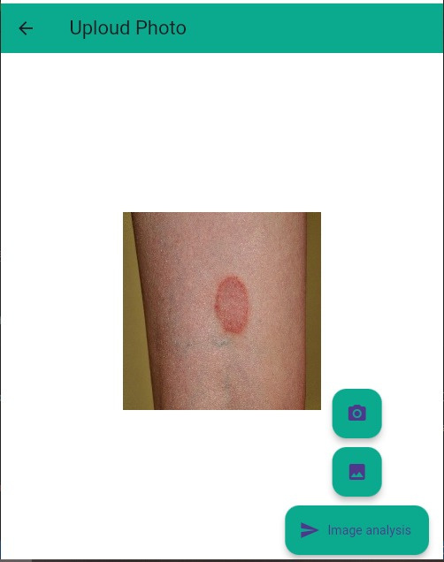
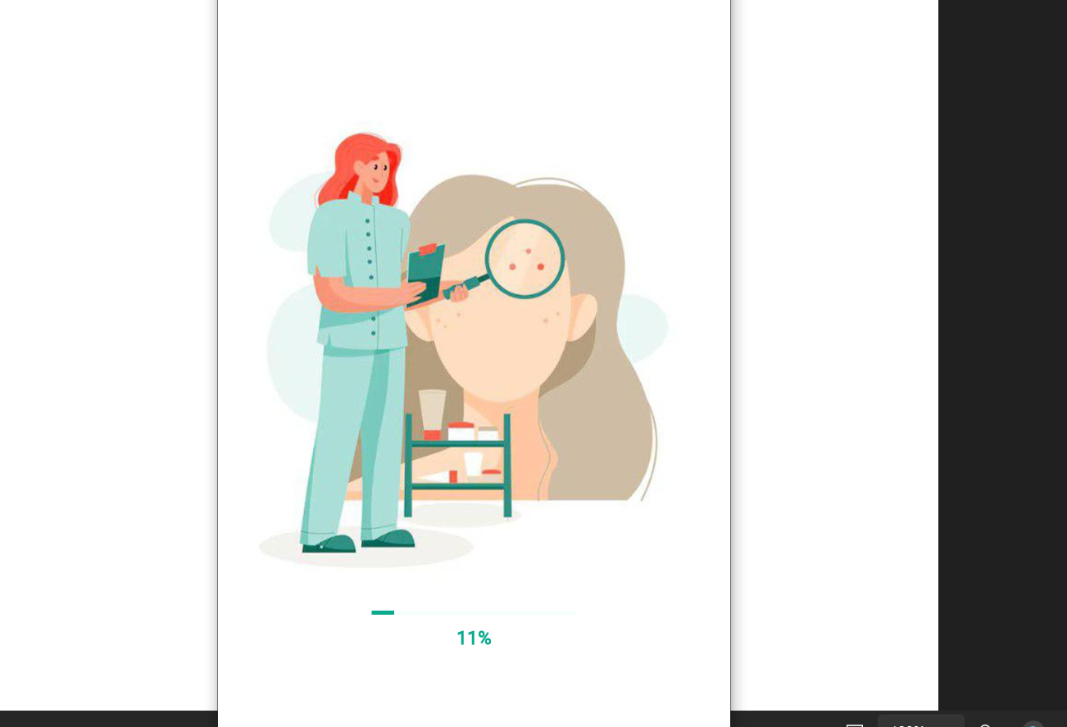

Analyzing the Image for Diagnosis
Figuer 15 : Loading & Analysis Page
The app is analyzing the image to diagnose the condition.

Slide 37
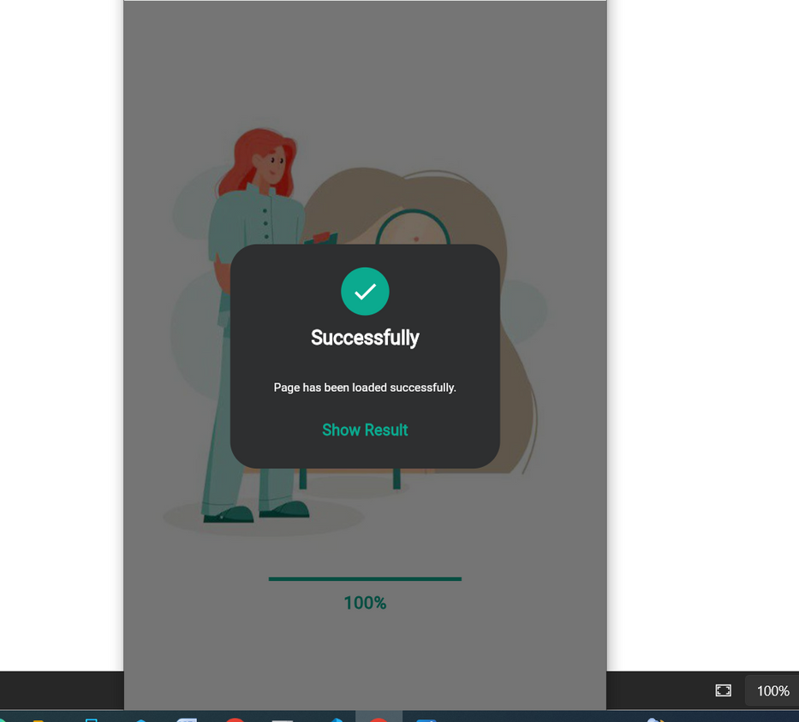
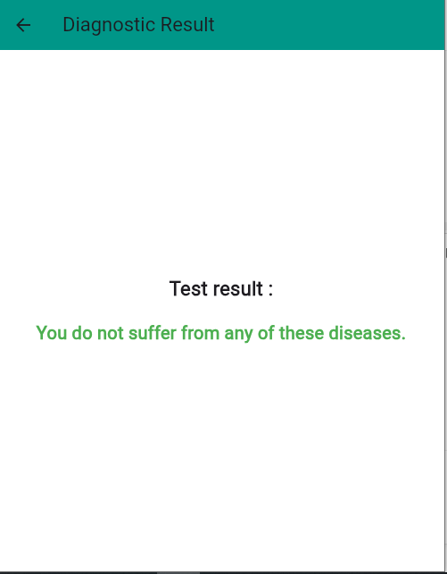
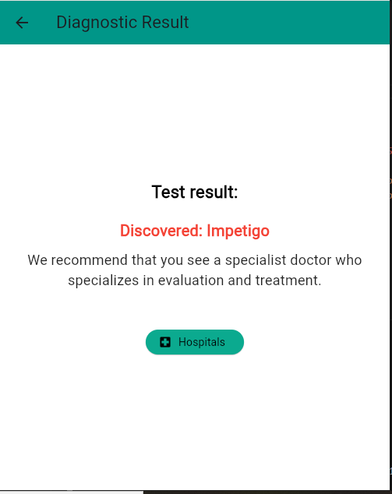
Figuer 16: Diagnosis Result page
The image analysis is complete. The system will now begin diagnosing whether the person is ill or not.

Slide 38
Diagnosis Complete
The system has determined that the person is affected by a condition.
You can now find hospitals in your governorate by clicking the "Hospitals" button.
Figuer 17: Find Hospitals Page

Slide 39
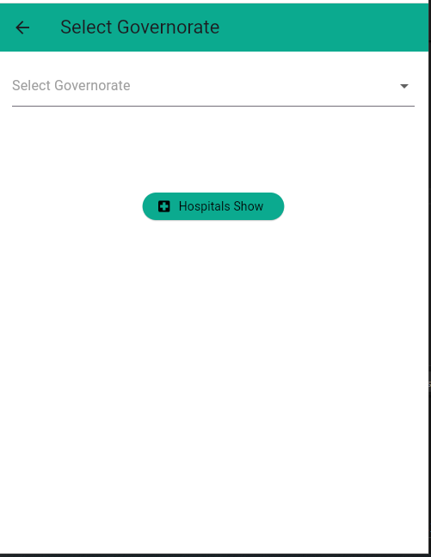
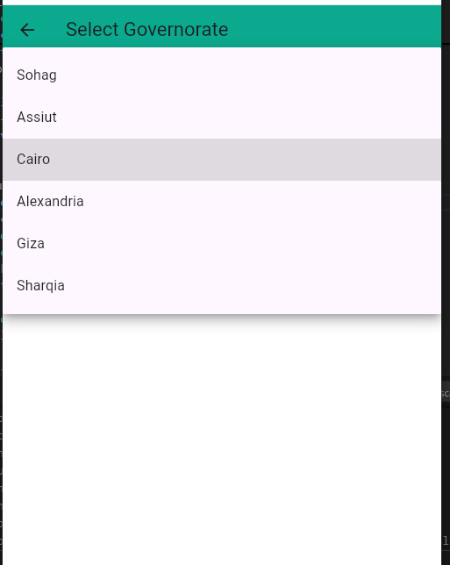
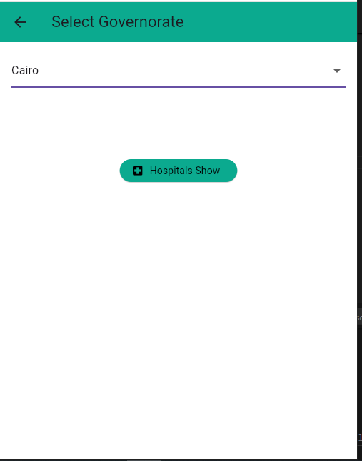
To find hospitals, click the "Hospitals" button.
Then, select your governorate
Figuer 18 : Select hospitals Page

Slide 40
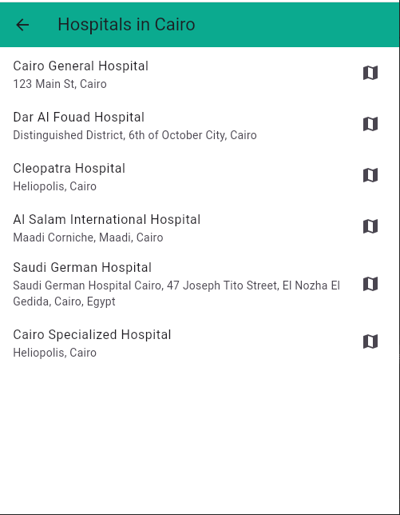
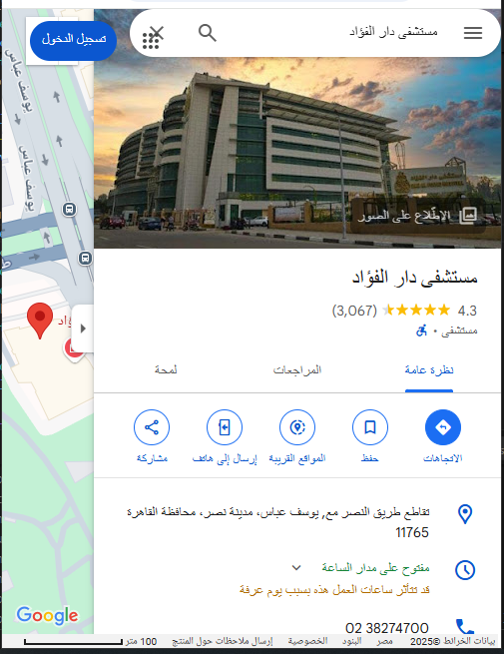
Tap "Show Hospitals" to view a list of hospitals along with their addresses.
Then, tap on any hospital to see its location on the map.
Figuer 19 : Map Page

Slide 41
Skin Disease Diagnosis Flask API
The Flask API handles receiving an image from the mobile app and diagnosing the skin disease using a trained EfficientNetB0 model.
The image is preprocessed and converted into numerical data suitable for prediction.
The model can detect 8 types of skin diseases and returns the most likely condition along with its confidence score.
The result is sent back to the app in JSON format for easy display.
This API acts as the smart link between the user interface and the AI model.

Slide 42
Result
6

Slide 43

Result

Slide 44
Tools
7

Slide 45
Tools
Technologies
Libraries
Tools
Flutter
Dart
Firebase
Python
Flask
Tensorflow
Efficientnet
ResNet50
VGG16
InceptionV3
MobileNet
1-Flutter
2-Dart
3-Firebase
4-Python
1-Vs Code
2-Anaconda
3-Android studio
Vs Code
Anaconda
Android studio

Slide 46
Conclusion
8

Slide 47
Conclusion
•In conclusion, this project aims to enhance the early detection and
diagnosis of dermatological diseases by using advanced technology.
•This project focus is not only on identifying skin conditions but also on providing actionable preventive measures that can help in reducing the spread of diseases.
• By offering a reliable tool for early diagnosis, we aim to empower
individuals with the knowledge to take timely actions in managing their health.
•Through the integration of deep learning, this project highlights the potential of technology to improve healthcare outcomes and provide accessible solutions for better skin disease prevention and management.

Slide 48
Future Work
9

Slide 49
Future Work
The following features are not currently available in the application but are planned for future development to enhance functionality and user experience:
Expanding the Disease Categories: Add more skin diseases to increase diagnostic coverage.
Enhancing and Exploring Model Performance: Improve accuracy by using better data and testing models like Vision Transformers and MixNet.
Integrating Doctor Consultation Feature: Allow users to book appointments with dermatologists through the app.
Diagnosis History Log: Store users' diagnosis records for future reference and tracking.

Slide 50
Time Plan
10

Slide 51
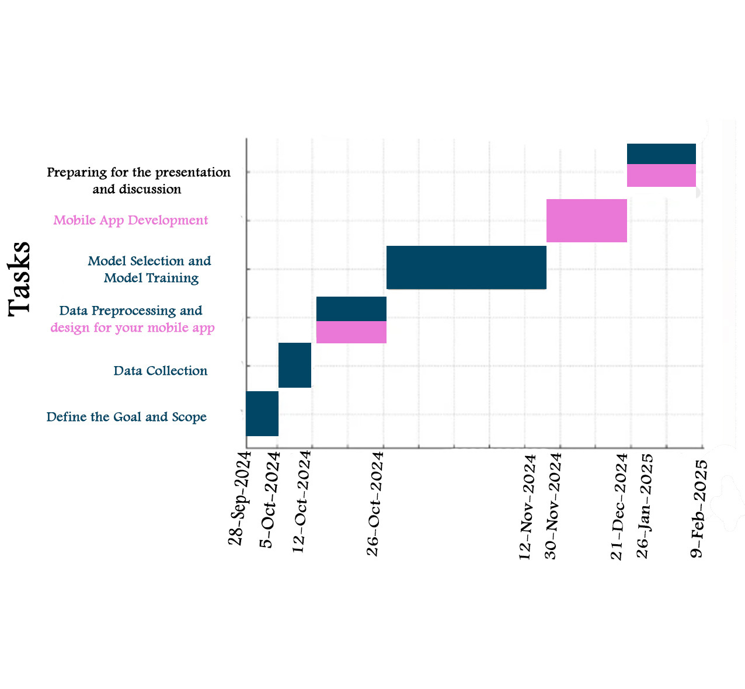
Time Plan

Slide 52
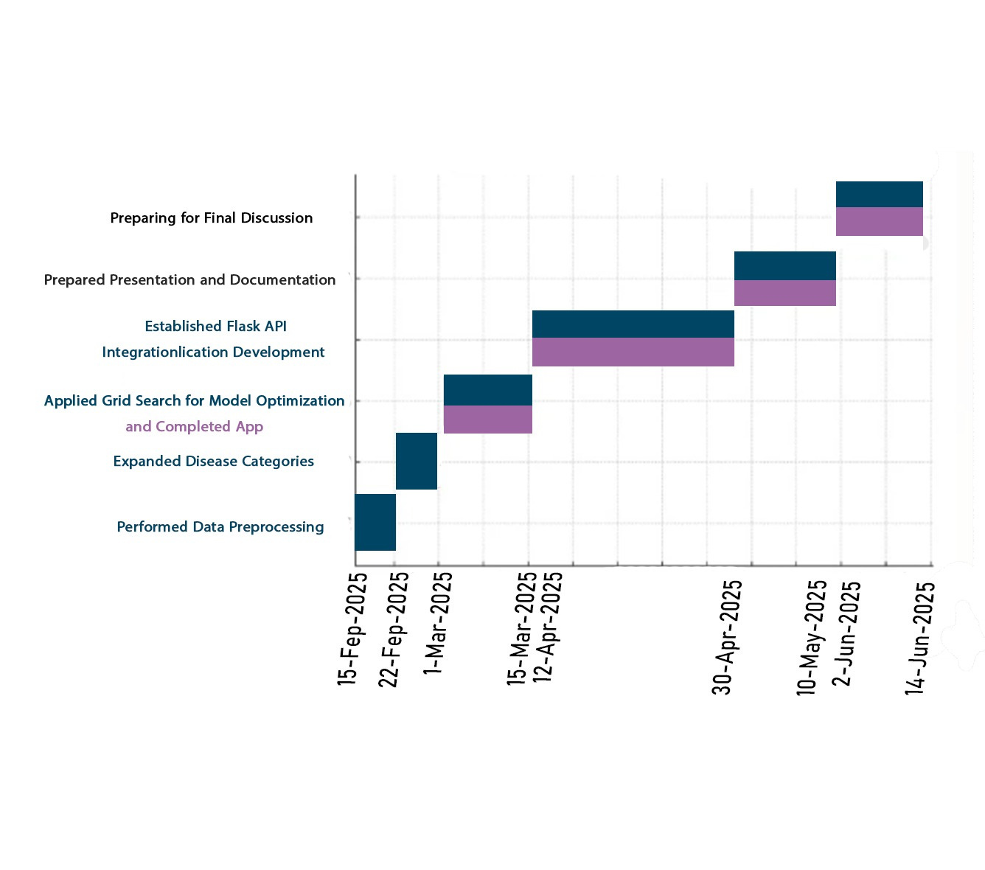
Time Plan

Slide 53
References
11

Slide 54
References
[1] AlEnezi, N. S. A. (2019). A method of skin detection using image processing and machine learning. Procedia Computer Science.
[2] Vakalopoulou, M., Christodoulidis, S., Burgos, N., Colliot, O., & Lepetit, V. (2025). Deep learning: Basics and convolutional neural networks (CNN). In O. Colliot (Ed.), Machine Learning for Brain Disorders (Chapter 3). Springer.
[3] GVP College of Engineering for Women. (2023). Skin detection using image processing and machine learning. Research Square.
[4] Meehan, T. (2019). Pragmatic Flutter.
[5]Biswas, S. (n.d.). Skin disease dataset. Retrieved from https://www.kaggle.com/datasets/subirbiswas19/skin-disease-dataset/data

Slide 55
References
[6]Jagdish, M. J., Gualán Guamangate, S. P., García López, M. A., De La Cruz‑Vargas, J. A., & Roque Camacho, M. E. (2022). Advance study of skin diseases detection using image processing methods. Natural Volatiles & Essential Oils, 9(1), 997–1007.
[7] Miola, A. (2020). Flutter complete reference.
[8] Biswas, S. (n.d.). Skin disease dataset. Retrieved from https://www.kaggle.com/datasets/subirbiswas19/skin-disease-dataset/data
[9] Flutter Documentation. (n.d.). Retrieved from https://docs.flutter.dev/
[10] Firebase Flutter. (n.d.). Retrieved from https://firebase.flutter.dev/

Slide 56
References
[11] Goodfellow, I., Bengio, Y., & Courville, A. (2016). Deep learning. MIT Press.
[12] LeCun, Y., Bengio, Y., & Hinton, G. (2015). Deep learning. Nature, 521(7553), 436–444. https://doi.org/10.1038/nature14539
[13] Chollet, F. (2017). Deep learning with Python. Manning Publications.
[14] Krizhevsky, A., Sutskever, I., & Hinton, G. E. (2012). ImageNet classification with deep (CNNs). Communications of the ACM, 60(6), 84–90. https://doi.org/10.1145/3065386
[15] Simonyan, K., & Zisserman, A. (2015). Very deep convolutional networks for large-scale image recognition. International Conference on Learning Representations (ICLR).

Slide 57
References
[16] Howard, A. G., Zhu, M., Chen, B., Kalenichenko, D., Wang, W., Weyand, T., ... & Adam, H. (2017). MobileNets: Efficient (CNNs) for mobile vision applications. arXiv preprint arXiv:1704.04861.
[17] Flutter Community. (n.d.). Flutter widgets catalog. Retrieved from https://flutter.dev/docs/development/ui/widgets
[18] Firebase. (n.d.). Firebase features and capabilities. Retrieved from https://firebase.google.com/products
[19] Szeliski, R. (2010). Computer vision: Algorithms and applications. Springer.
[20] Raj, A., & Sharma, P. (2020). An overview of CNN architectures and applications. International Journal of Computer Science and Information Security, 18(3), 55–65

Slide 58
MEDICAL
HEALTH CARE
THANK
YOU!

